Slide 1


Slide 2
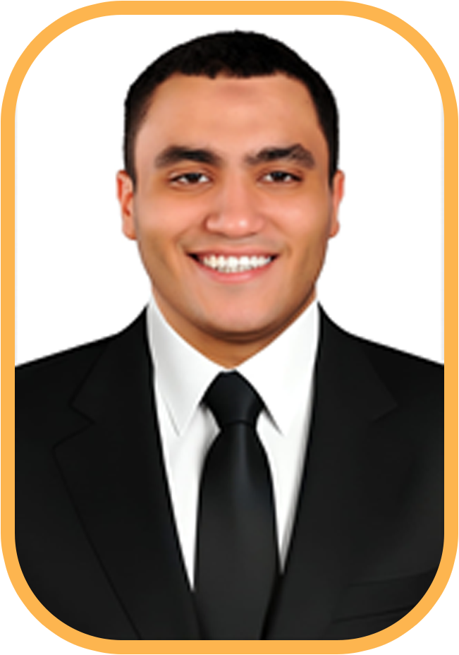
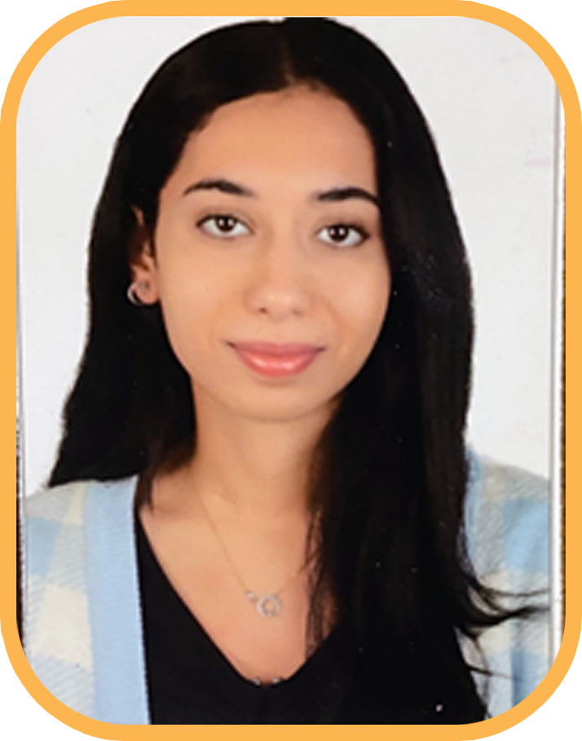
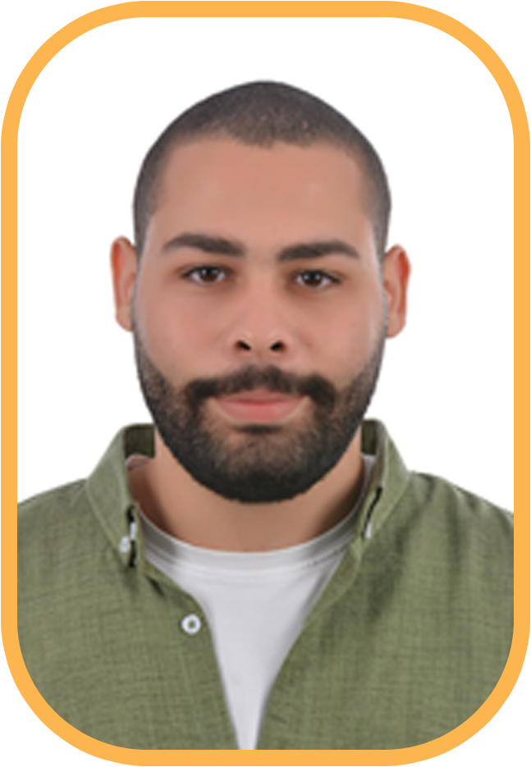
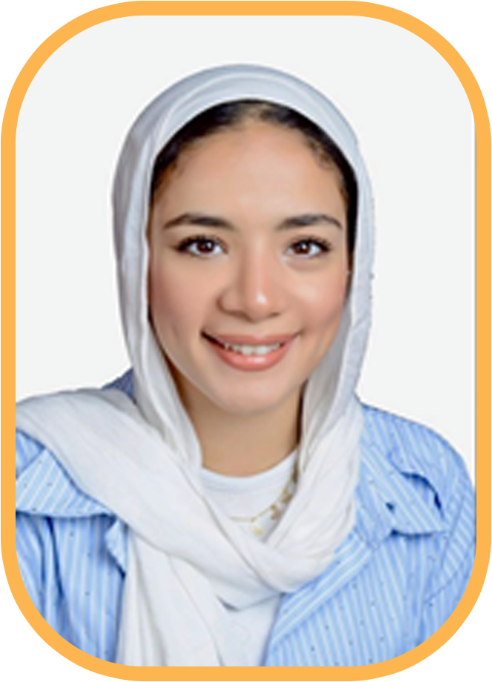

Our Team
Farouk Ashraf
Team Leader
Farah Hisham
Mahmoud Hany
Bassant Mohamed
Mohamed Ahmed

Slide 3
Introduction
This data analysis project seeks to move beyond evidences and provide a
clear, data-driven perspective on the state of Egypt’s workforce. By
systematically collecting, cleaning, and analyzing relevant datasets from
national labor force surveys and educational statistics to economic
indicators and private sector reports, and presenting the insights by the
storytelling technique, as we aim to uncover the underlying patterns and
trends shaping employment in Egypt.

Slide 4
Our Steps for analyze the data:
1- Knowing Our Problem and our Stakeholders
2- Data Collection
3- Data Cleaning & Processing
4- Data Integration
5- Data Analysis
6- Data Visualization

Slide 5
Who are our stakeholders?
The Ministry of Manpower: Directly concerned with employment rates, labor market regulations, and skill matching between citizens and available jobs.
The Ministry of Education & Technical Education: Centrally concerned with aligning educational outcomes with labor market needs, ensuring graduates possess the skills demanded by the modern economy.

Slide 6
Business Problem?
Egyptian digital freelancers are systematically under-earning compared to regional and international counterparts, despite their high technical skill and large numbers.
This disparity is primarily attributed to a strategic misalignment between the skills Egyptian freelancers offer and the current high-value demands of the global digital marketplace.
The female labour force participation rate is persistently low.
A vast majority of the Egyptian workforce lacks the foundational computer literacy and digital skills required for modern high-value jobs.

Slide 7
Asking Questions to solve the problems
we used S.M.A.R.T technique to ensure that we get to the problem correctly and fix it from its roots.
1-What is the required investment (budget and timeline) to establish a comprehensive National Freelancer Registration Platform that will enable the documented tracking necessary to achieve a 10% increase in the count of registered freelancers by Q4 2030, and what key regulatory barriers need to be removed within the next 18 months?
2-To ensure 60 % of all registered freelancers achieve a high-skilled certification by Q4 2028, what are the three most critical, in-demand skill sets we must prioritize, and what specific training budget is needed per freelancer to cover subsidized certification costs?
3- what specific public policies and private sector are required to raise the national female participation rate by 5-8% percentage points to reach a target of 20% by the end of 2030?

Slide 8
Data Collection

Slide 9
Data Collection
Data Source: The data was collected from the official website of the Central Agency for Public Mobilization and Statistics (CAPMAS) and The Egyptian Center for Economic studies (ECES).
Our Data: Population Census and Housing Conditions (Extended Form)Governorates
Economic Statistics Handbook of the Arab Republic of Egypt

Slide 10
Data Processing & Cleaning

Slide 11
Data Processing & Cleaning
1- Format Conversion
-Converted the dataset from an unanalyzable format (PDF) into
analyzable formats (Excel/CSV).
-Ensured all tables and numeric data were correctly extracted.
2- Error Correction & Standardization
-Fixed data entry errors, missing values, and format inconsistencies.
-Standardized column names and ensured uniform data types for analysis.

Slide 12
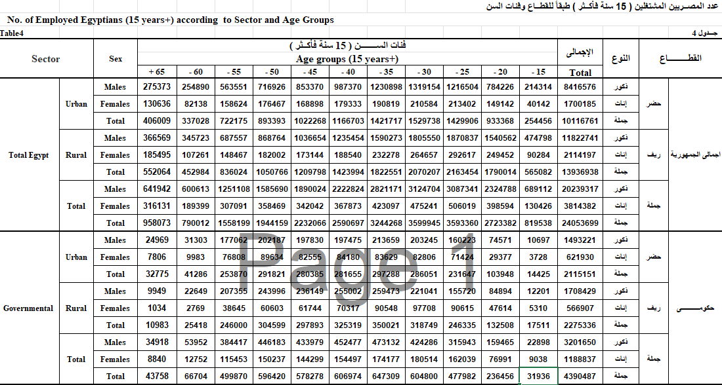
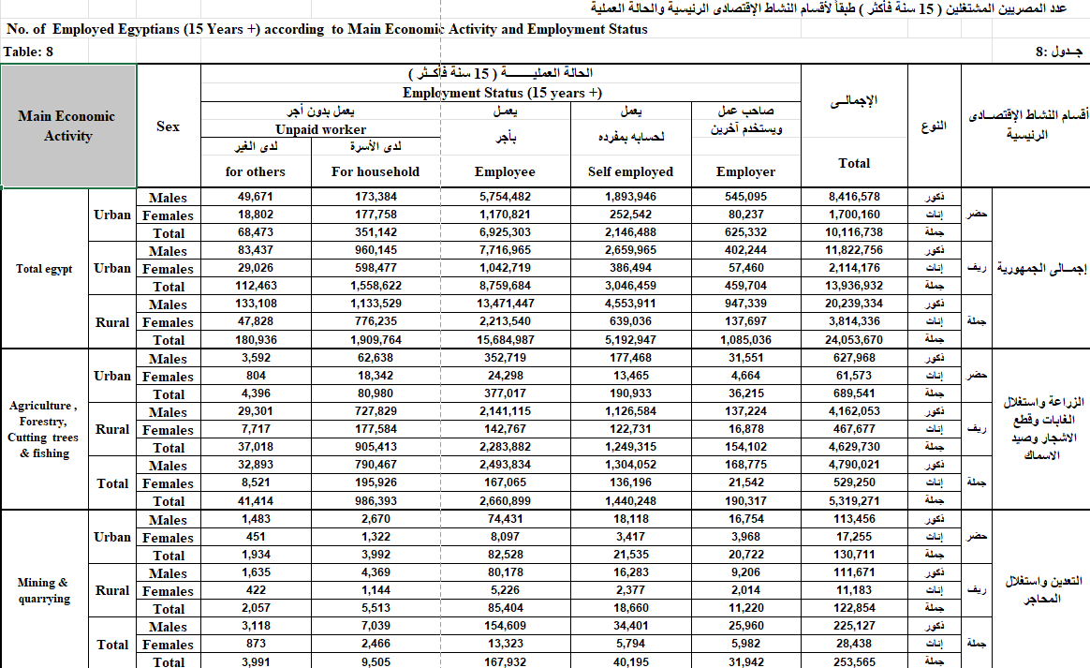
Turning Our Unstructured data into structured data we can use for our analysis

Slide 13
Error Correction & Standardization
Source Validation: The dataset was acquired from the official CAPMAS portal, providing a verified and authoritative foundation.
Type Integrity Check: The data exhibited no type conversion errors due to a structured collection process that enforced appropriate data types at the point of entry.
Value Standardization: Addressed inconsistencies through data cleaning techniques, including resolving fuzzy matches to ensure categorical uniformity.

Slide 14
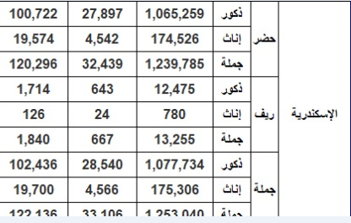
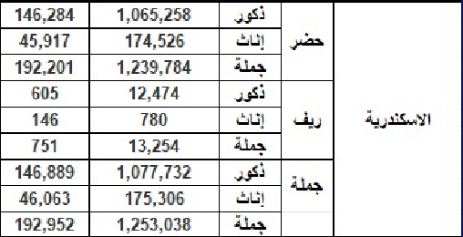
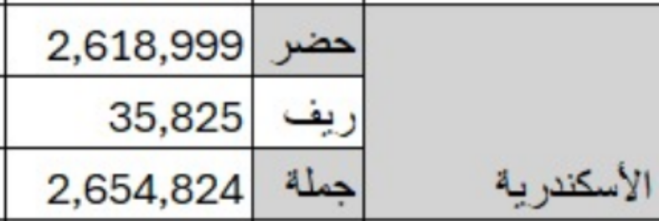
Sample of fuzzy matches we faced

Slide 15
Data Integration

Slide 16
Data Integration
→Our data infrastructure leveraged the strengths of SQL:
SQL Database: Served as the central repository, using a structured star schema with fact and dimension tables to ensure data integrity and relational clarity.

Slide 17

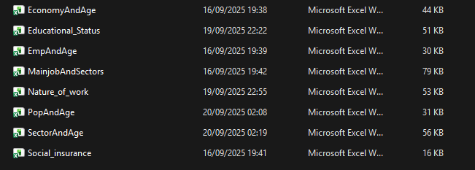
Something to Notice
The phase requires importing 8 final data files into a SQL database for our analysis In Python.
Manually importing such a kind of high volume of files is inefficient and Exhausting doing it one by one.

Slide 18
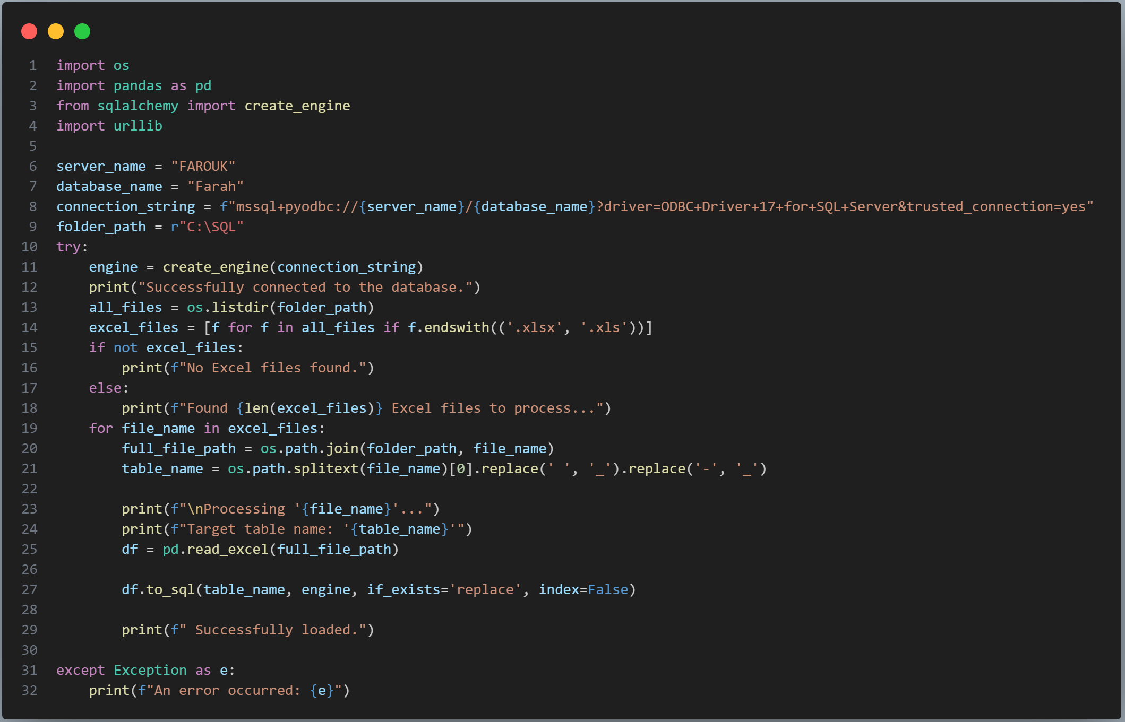
So we used the principle of Data Automation using Python

Slide 19
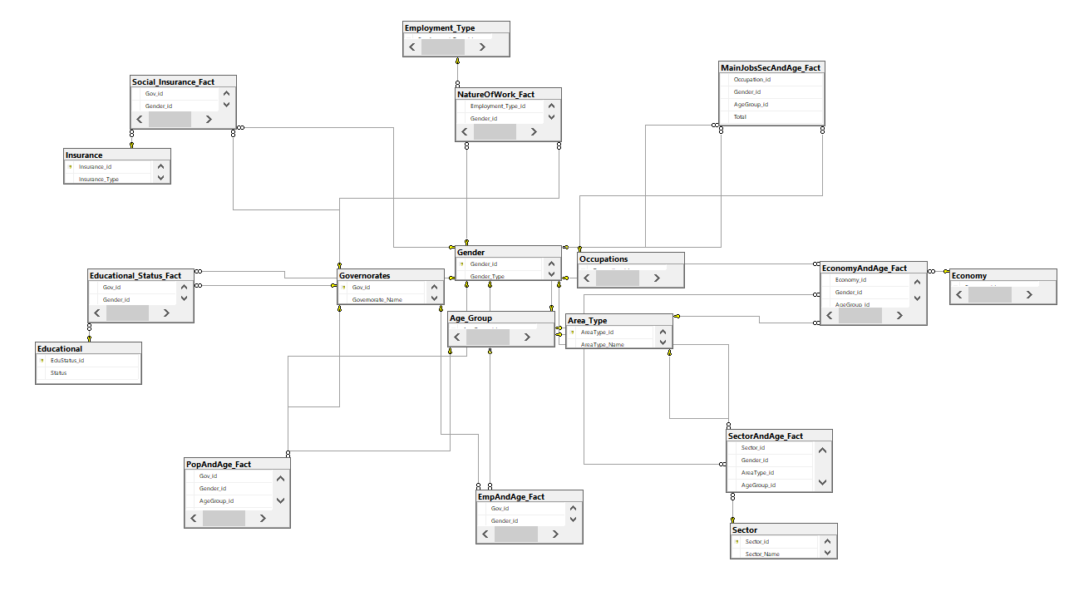
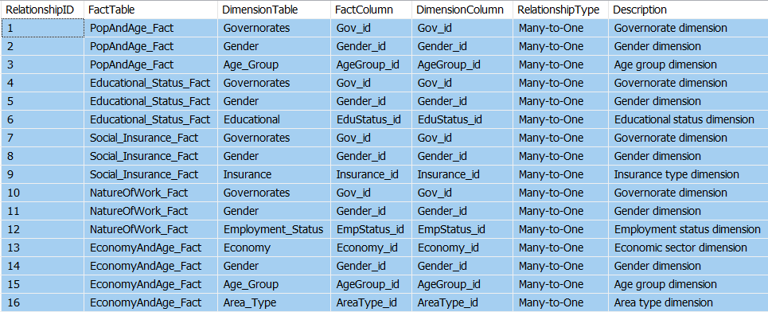
Data Modeling in SQL

Slide 20
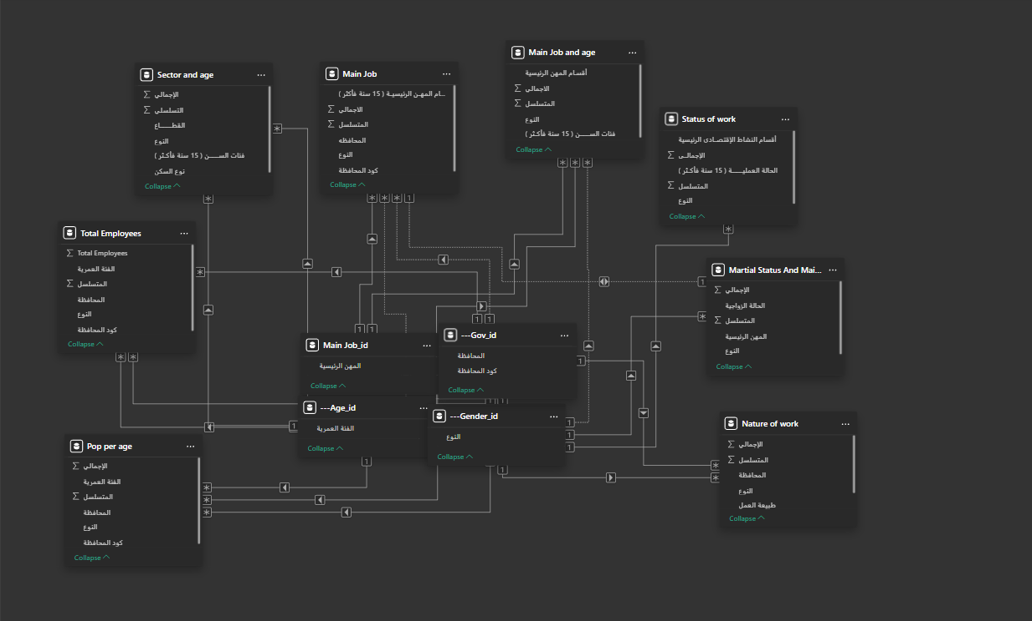
Data Modeling in Power BI

Slide 21
Data Analysis

Slide 22
Data Analysis
Data Analysis: What the Numbers Say
Identified key patterns and trends in workforce distribution
Calculated unemployment rates across demographics and regions
Analyzed correlations between education levels and employment sectors
Used statistical methods to validate findings

Slide 23
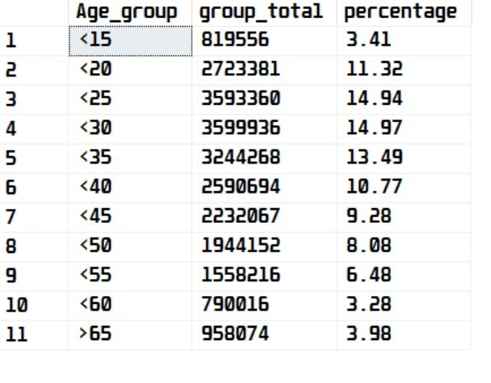
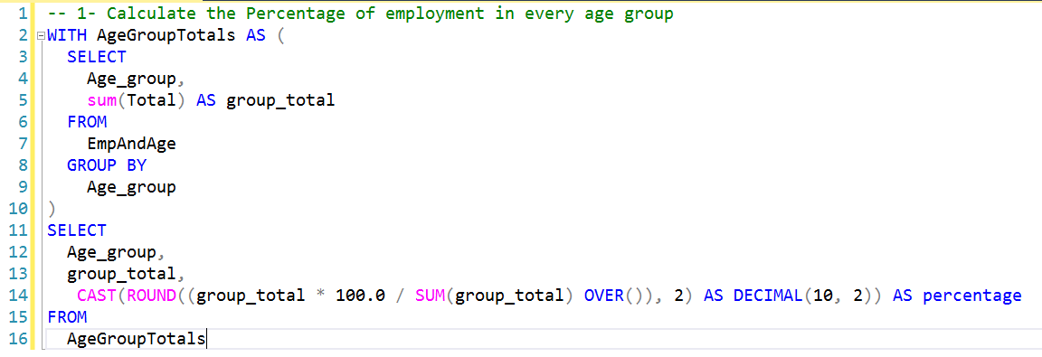
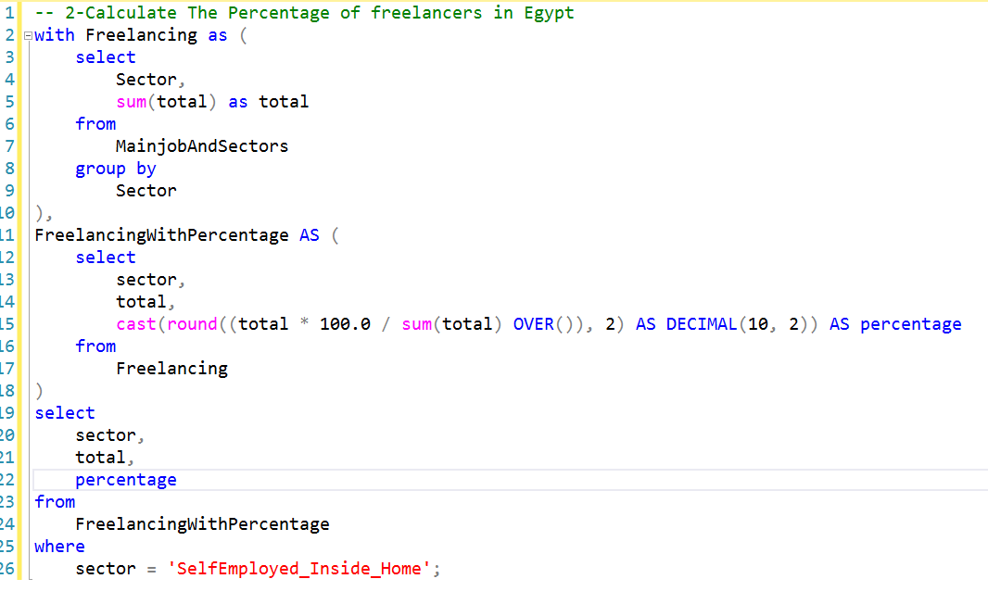
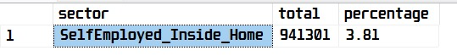
Analyzing Data in SQL

Slide 24
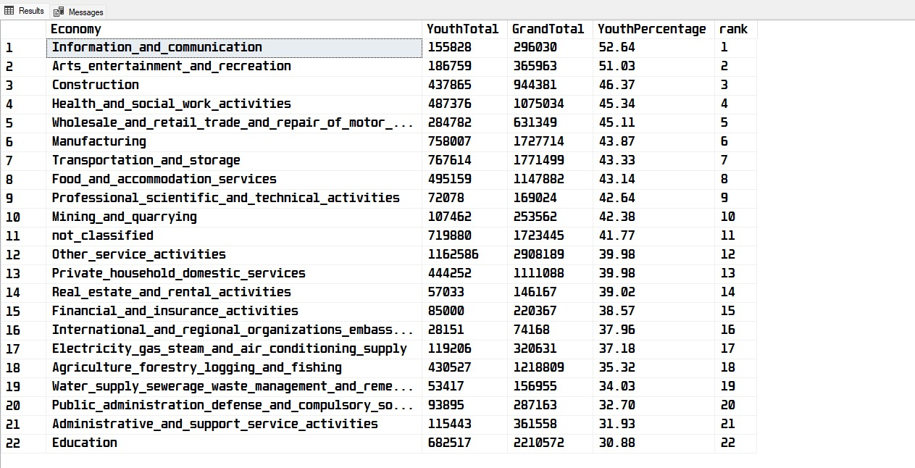
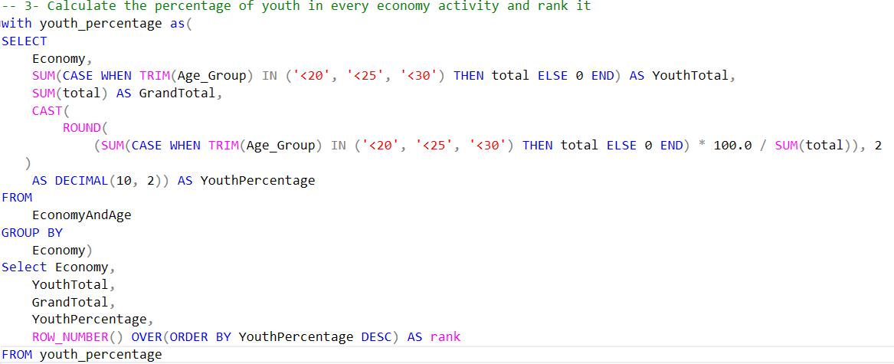
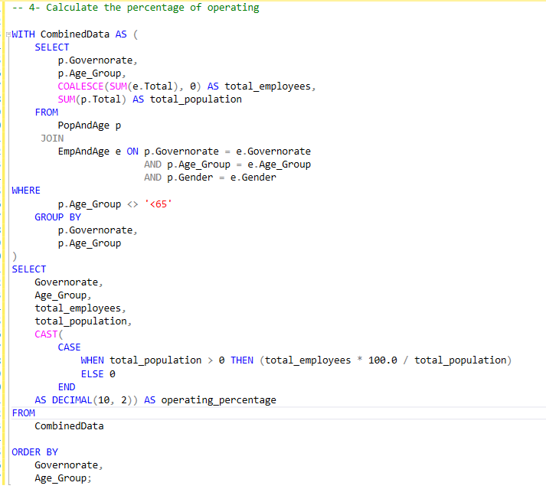
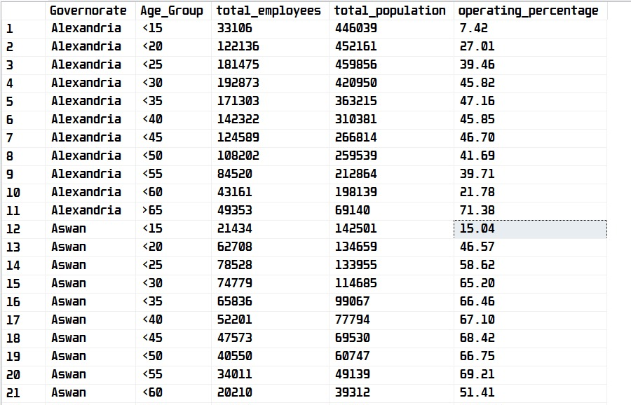
Analyzing Data in SQL

Slide 25
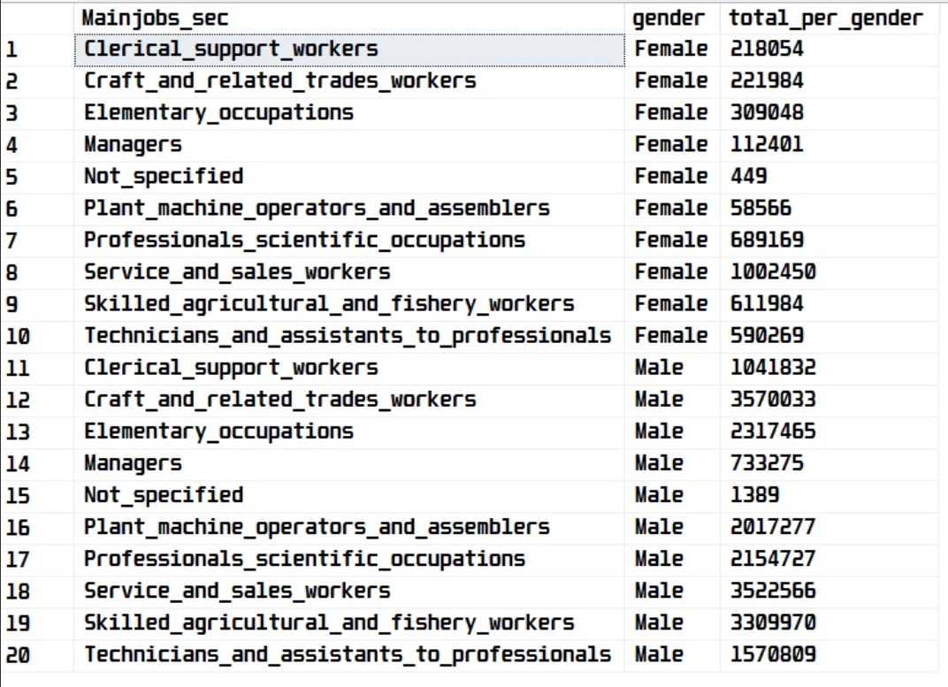
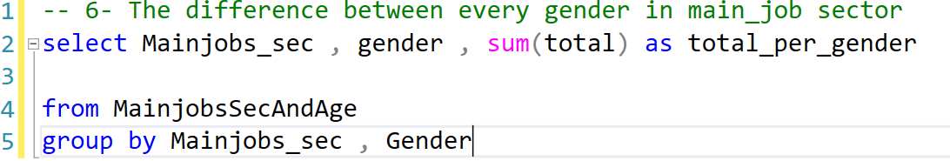
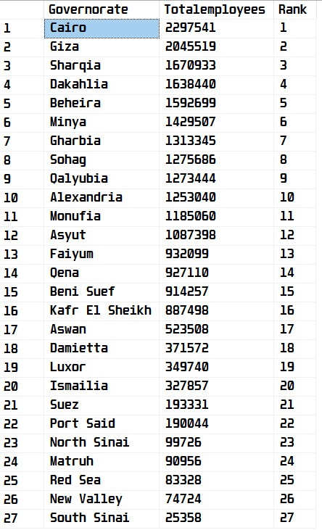
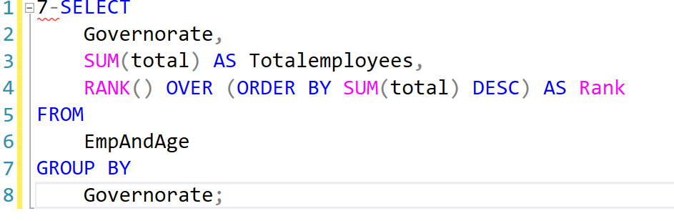
Analyzing Data in SQL

Slide 26
Data Visualization

Slide 27


Data Visualization
We divided our data into three categories:

Slide 28
1- Education & Workforce in Egypt
From Data to Insight: Our Visualization Stack
We transformed complex workforce data into clear, interactive narratives using a multi-tool approach:
→Power BI: For interactive dashboards
On employment and demographics.
→ Tableau: For advanced, custom statistical plots.
→ Python: For dynamic maps and regional trend analysis.

Slide 29


Combining the Workforce & Education with The Beauty of Python

Slide 30
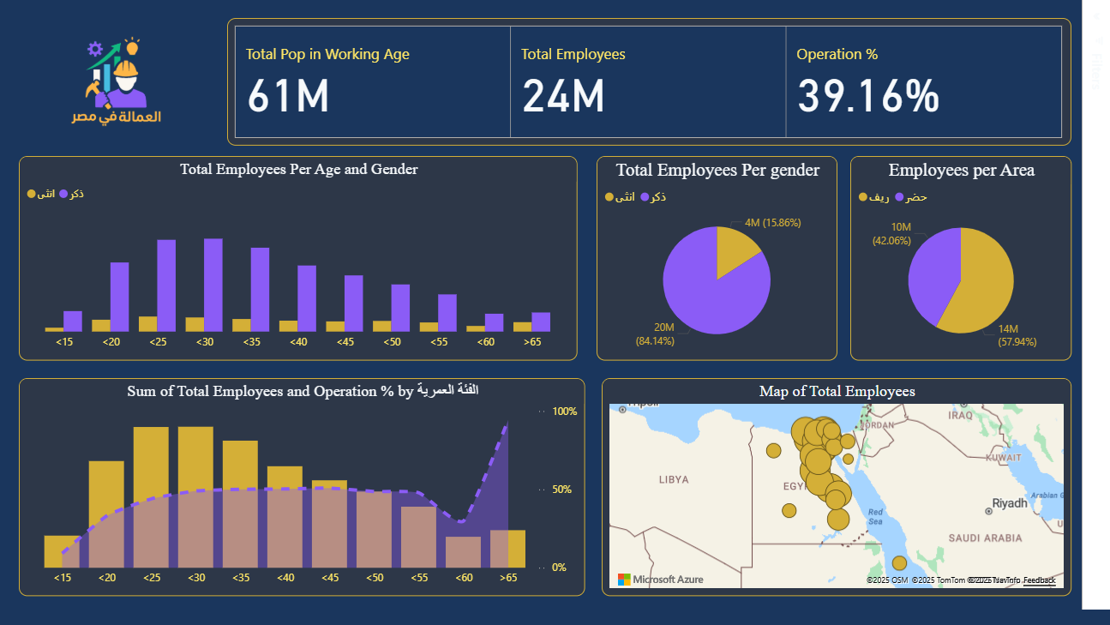

Slide 31
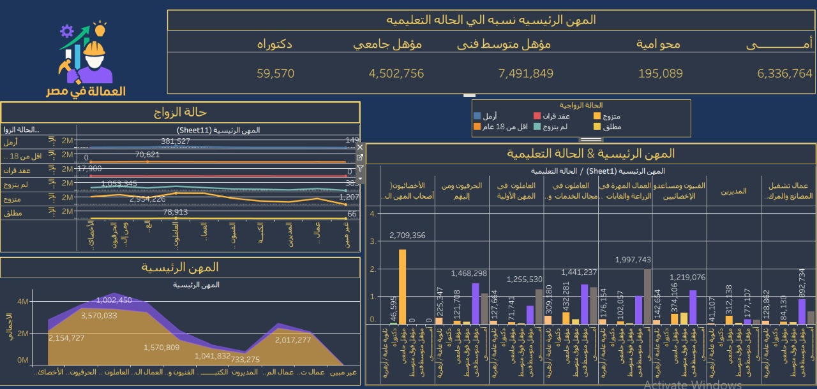

Slide 32
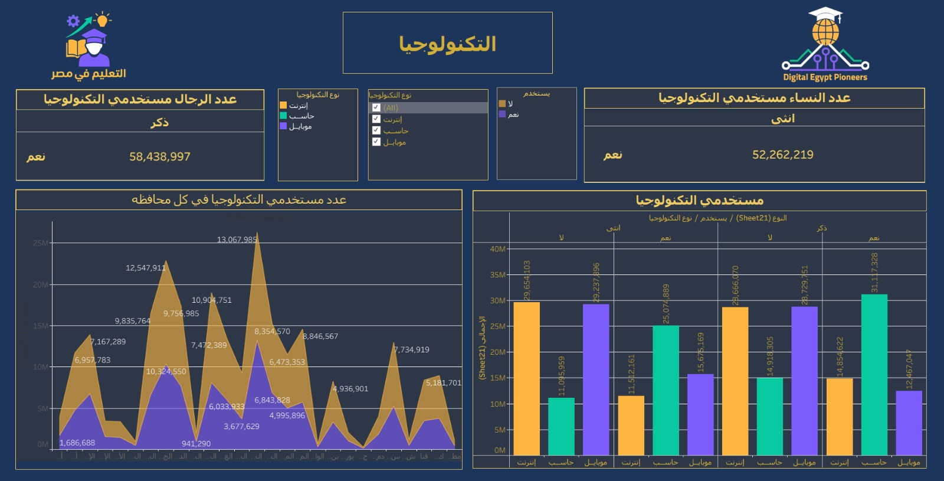

Slide 33
2- Freelancing in Egypt
The Gig Economy in Egypt
We analyzed freelancing as a vital part of the modern workforce:
Rapid Growth: Tracking the year-over-year surge in freelancers and popular platforms.
Top Skills: Identifying high-demand fields like tech, digital marketing, and content creation.
Key Demographics: Visualizing the age, location, and education of freelancers.
Economic Impact: Measuring its role in youth employment and supplemental income.

Slide 34
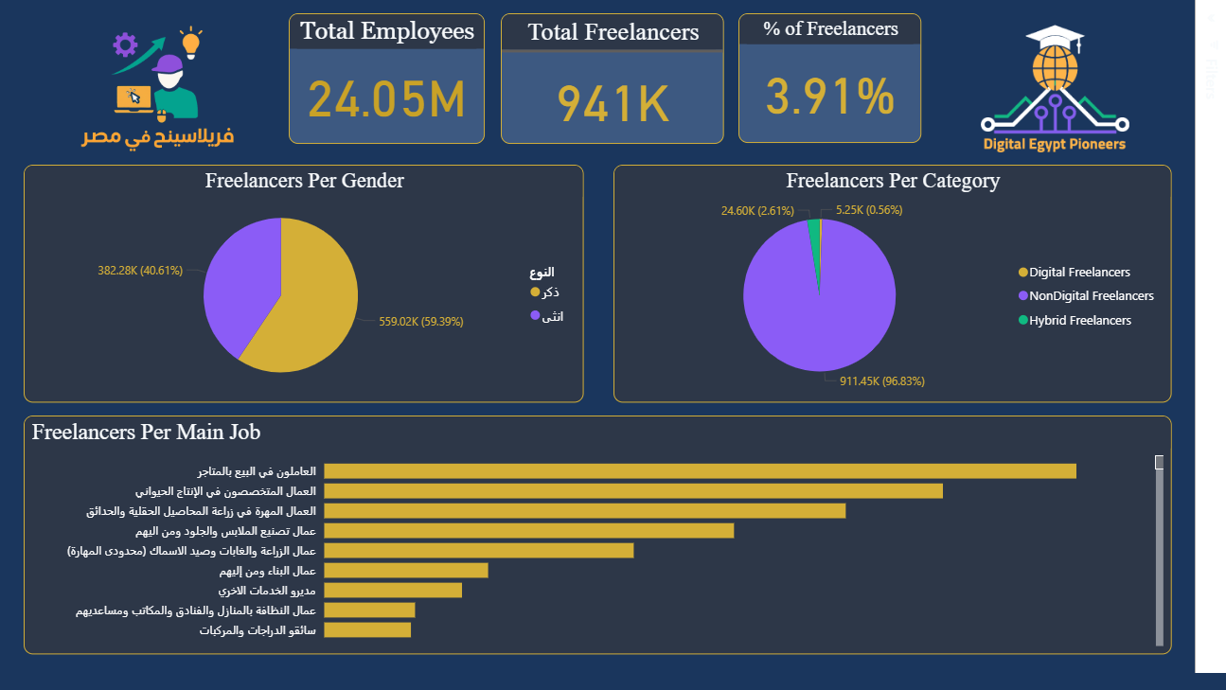

Slide 35
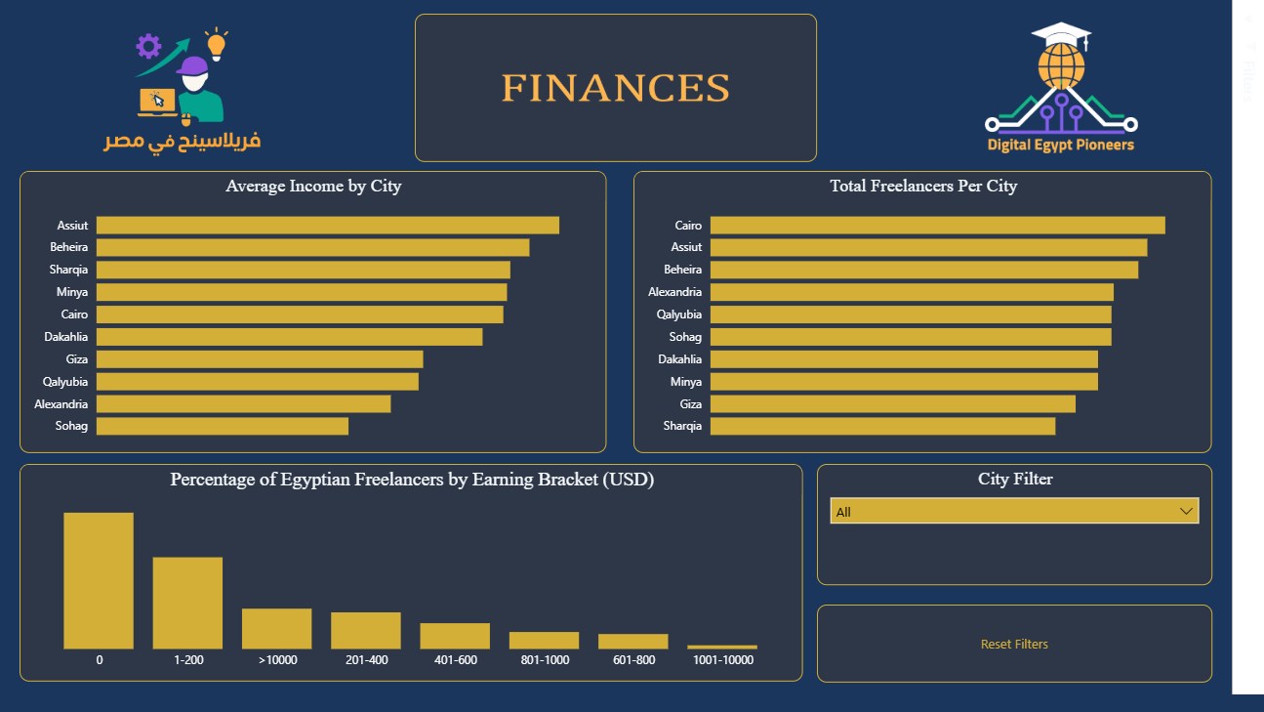

Slide 36
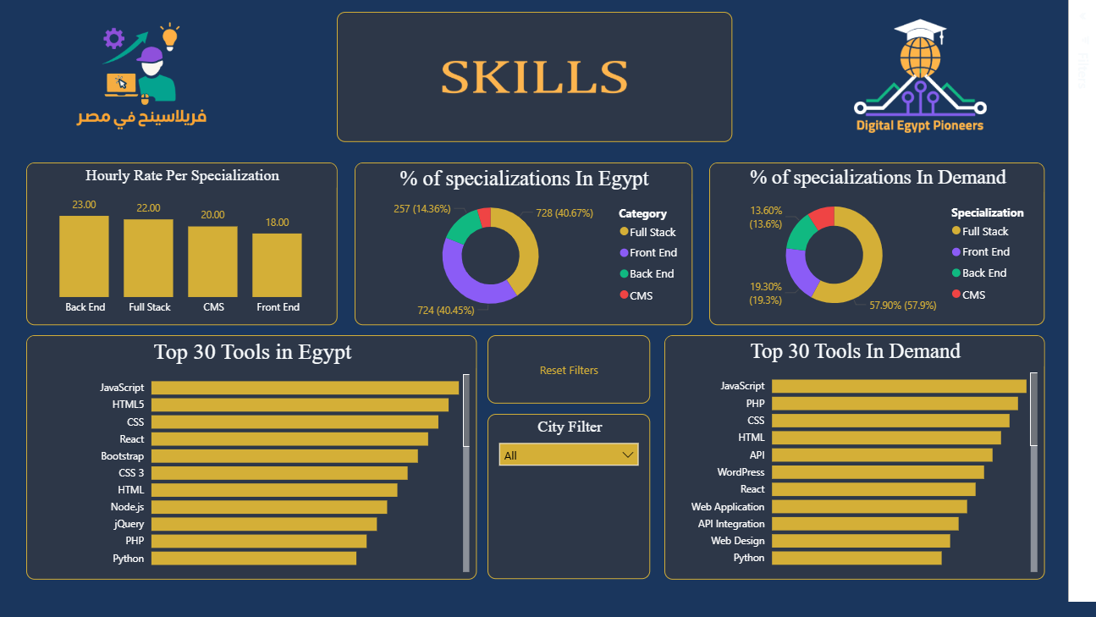

Slide 37
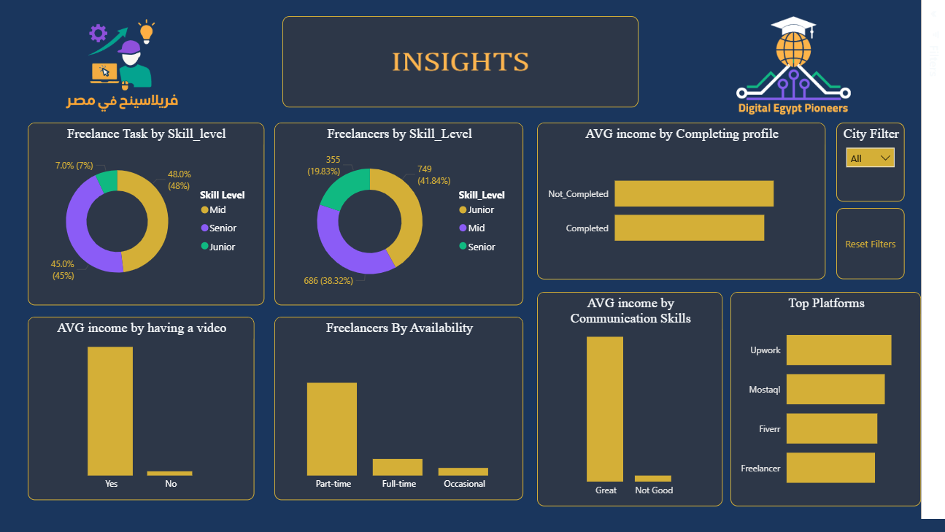

Slide 38
Tools Used
1- Excel
2- Power BI
3- Tableau
4- Structured Query Language (SQL)
5- Python
(NumPy, Pandas, Matplotlib, Seaborn, and Streamlit)

Slide 39
Recommendations
1- Increase the female operation ratio by 5-8% within 18 months by providing freelancing awareness and providing more part-time and remote jobs that suits women more.
2- It is essential to recognize and spread awareness that every freelancer has the right to compensation for their work, irrespective of the project's scale or duration. All services delivered represent valuable professional effort by organizing lectures to spread awareness (especially in Cairo).
3- Providing personal computing solutions for the contemporary general user at a reasonable price
To make more people learn the fundamental skills of digital skills and to work as freelancers.
4-Our objective is to bridge the skills gap by offering comprehensive internship opportunities that equip all participants with the core proficiencies of future-proof careers.

Slide 40
After the analysis
Now that our recommendations have been implemented, let’s look at what’ve changed.
1- Increased the operation percentage for women by 5% (17% now) by providing more suitable employment opportunities for women across various sectors.
2- Awareness courses and seminars for freelancing were organized for every freelancer to educate them about their right to receive payment for work, regardless of its size. Consequently, the percentage of individuals not being paid on freelance platforms has been reduced by 15%.
3- Because of the awareness of freelancing among the population, operation percentage has been increased to 44.2% and the total freelancer's percentage has been increased to approximately 20% which made Egypt ranks 9th globally in online freelancing contributing 2% of the world’s online freelance workforce ( Article ).
4- Providing more computing solutions made the percentage of non-technology users decreased to 14%.

Slide 41
“ Things only get better thru change, not chance.”

Slide 42

Thank You

